Slide 1
PROJECT
COMPETITION

Slide 2
Outline
General info.
Timeline.
Application.
Topics.
Prizes.
Q/A.

Slide 3
General info
Student competition.
Connecting faculty and industry.
Real world problems.
Work in teams or alone.
Can count as your coursework.

Slide 4
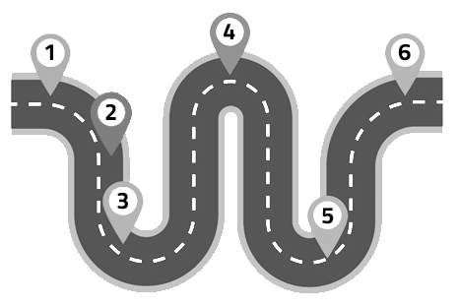
Timeline
1 Info meeting [today].
2 Application deadline [Jan 31st].
3 Competition start [mid Feb].
4 Interim report [April].
5 Final report [end of May].
6 Grand finals [early Jun].

Slide 5
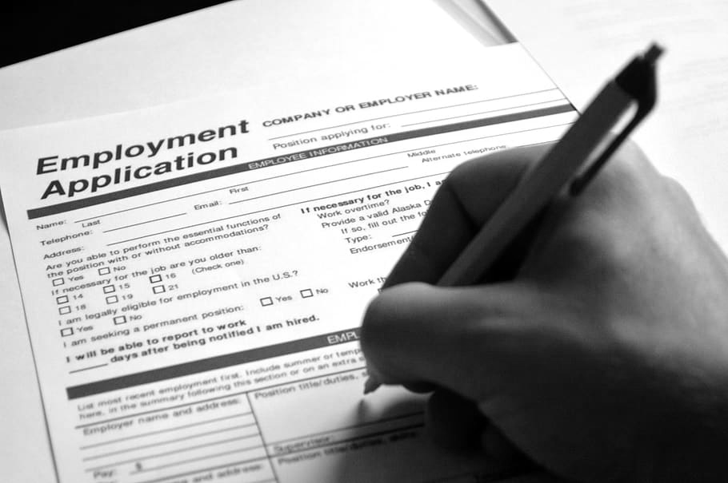
Application
Team members [1-3].
Motivation letter [max 1 page].
Topic bidding. [Rank all topics from 1 (best) to N].
One application per team.
Submit to [datascience@fri.uni-lj.si].
Deadline [9st Feb 2020, 23:59].

Slide 6

Topics
Only a brief overview.
More details on [datascience.fri.uni-lj.si/competition].

Slide 7

Predicting the number of master designs
Image analysis.
Clustering.
Deep learning.

Slide 8
Predicting the required time for production of the advertisement material
Predictive modelling.
Statistical analysis.
Outlier detection.

Slide 9

Smart cities monitoring and control
Data analysis.
Statistical modelling.
Machine learning.
Exploratory data analysis.

Slide 10

Optimizing a search engine for legal documents
Search engine.
Legal terms.
Optimization.
Natural language processing.

Slide 11
Constructing a dictionary of legal terms
Dictionary.
Legal terms.
Text analysis.
Natural language processing.

Slide 12

Time series forecasting with exogenous variables
Time series.
Survey.
Machine learning.
Statistics.

Slide 13
Dimensionality reduction for multivariate time series data
Time series.
Dimensionality reduction.
Feature selection.
Machine learning.

Slide 14

Predicting the optimal bid in an online ad auction
Incremental learning.
Density forecasting.
Machine learning.
Statistics.

Slide 15
Predicting ad success
Incremental learning.
Classification.
Machine learning.
Statistics.

Slide 16

Prizes
1st place [1500€].
2nd place [750€].
Best presentation [450€].

Slide 17
Q&A

